Slide 1
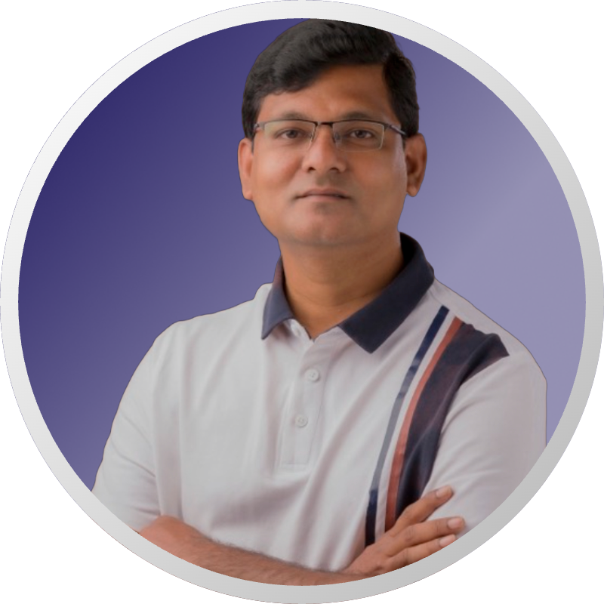

Personal Pitch Deck-Srimugunthan
by Srimugunthan Dhandapani

Slide 2
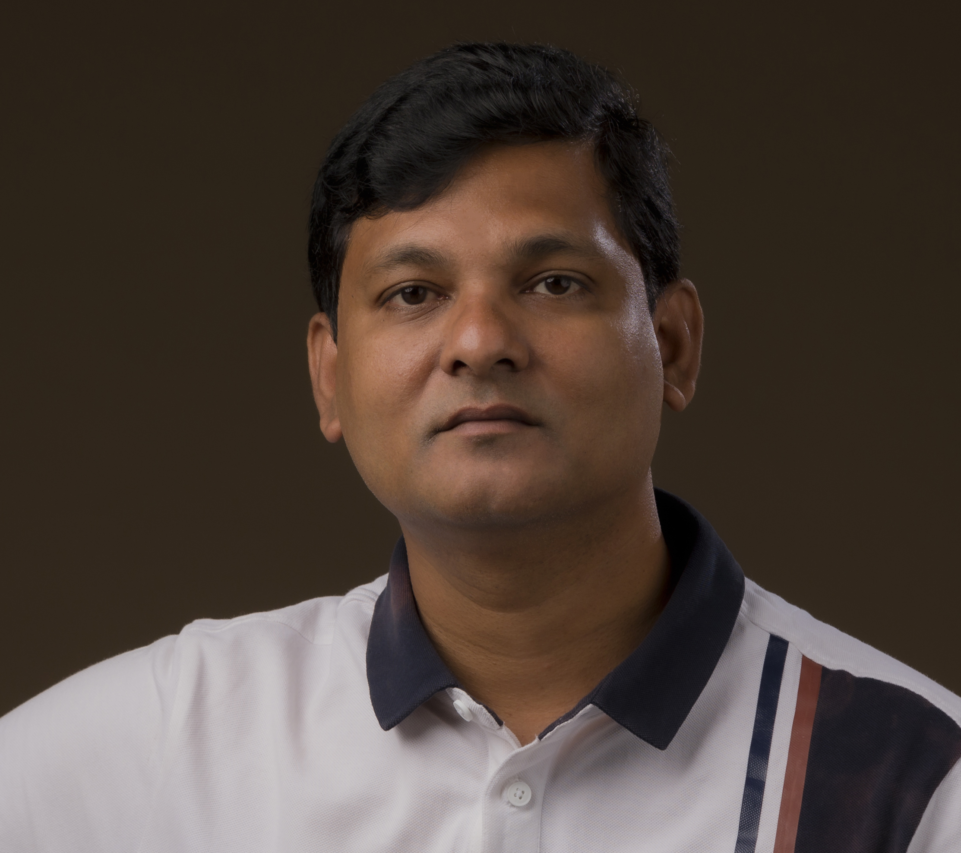
Who I Am –My career Story
I work as Datascience-Lead @ Wellsfargo
Three Degree holder.
B.E in computer Science, MIT chennai
MSc(Engg) in Computer Science, IISc Bangalore
Executive MBA in Product management, IPL Bangalore
Started my career as Embedded systems Engineer. Periodic pivots and constant learning led me to my current position as Datascience-Lead.
What I believe in:
Contribution, Impact, Providing Value, Innovation, Relationships, Growth mindset, Agency

Slide 3

My Experience -Summary
14 year Experience
10 year Experience
4 year Experience
Experience as Data Analytics professional
Experience as Datascience-Technical Lead
Experience as Tech professional

Slide 4

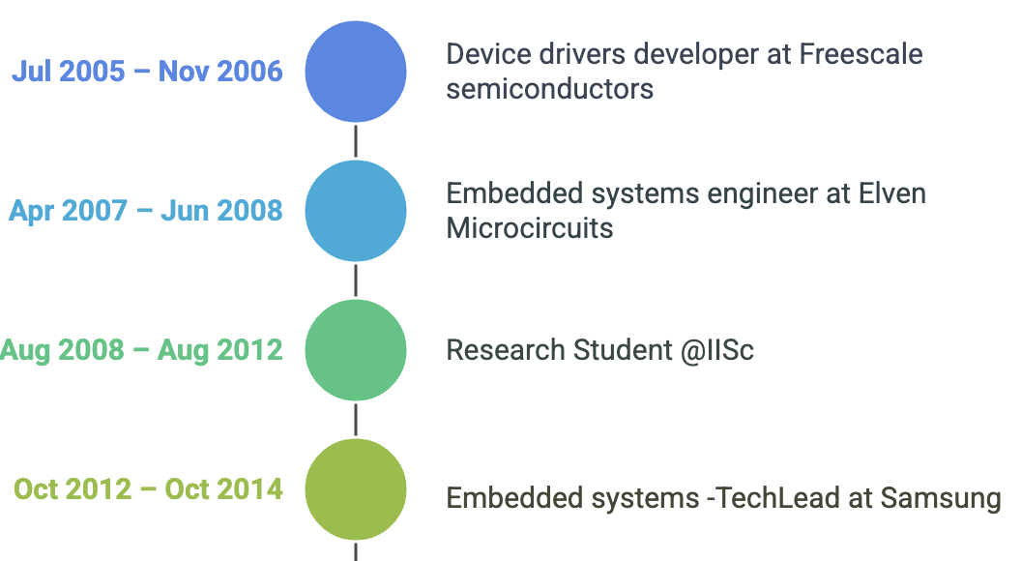
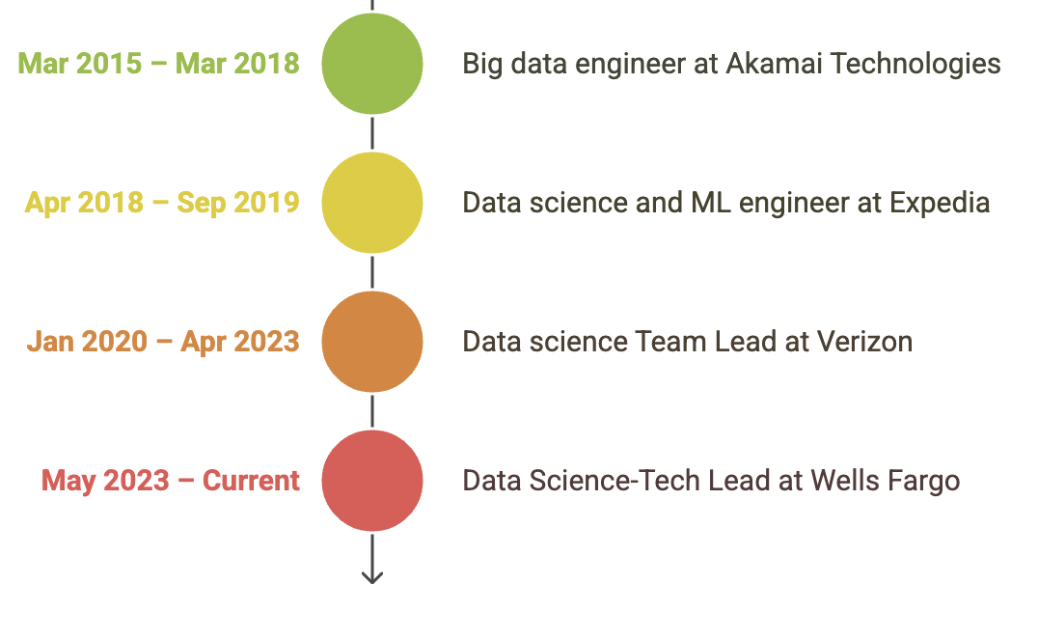
Timeline of Experience

Slide 5
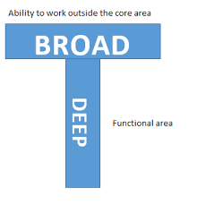
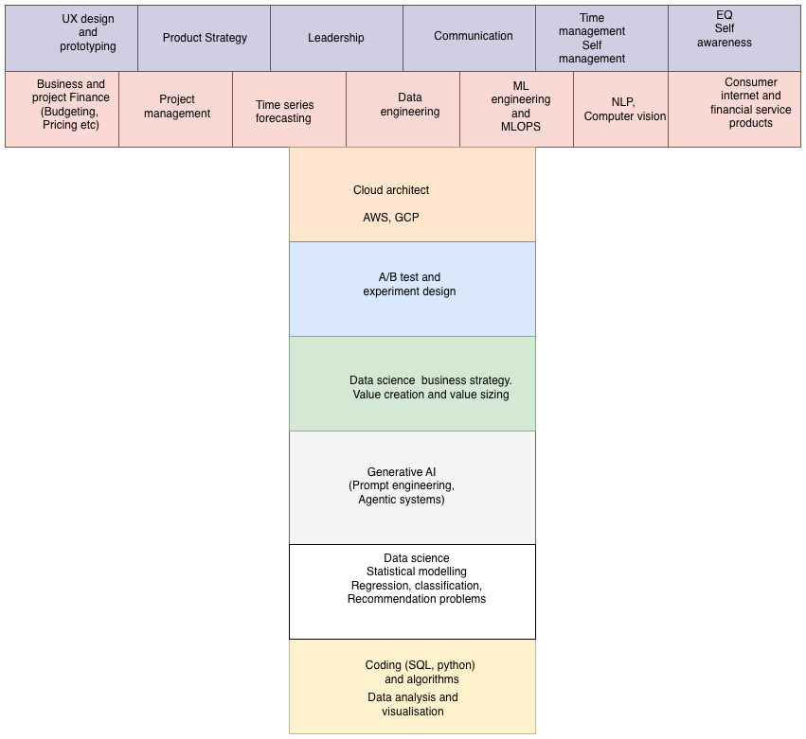
My T-shaped Skillset

Slide 6



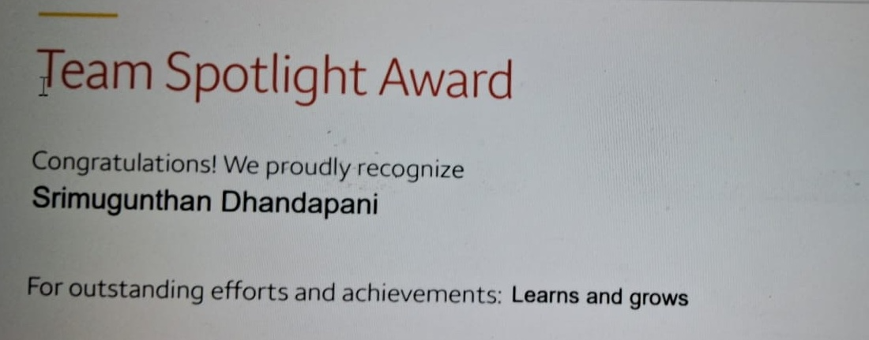
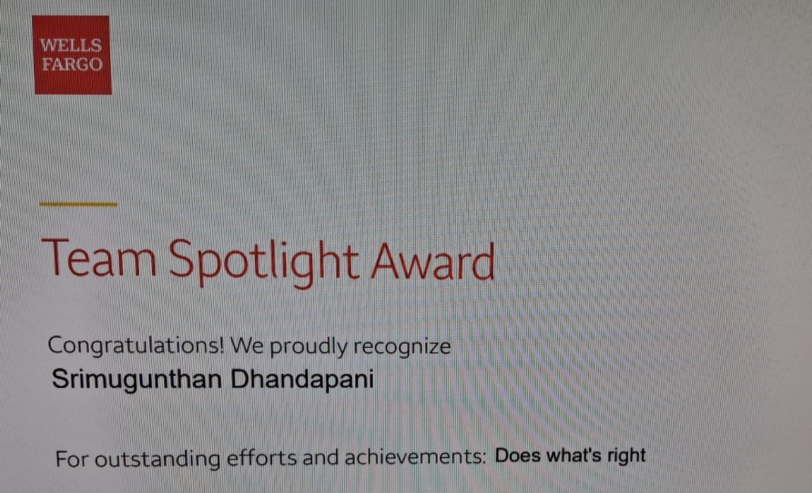
Achievements and Milestones
Successful Projects
Awards in Wells fargo last year
- Led a project across 3 different usecases for AI driven coaching which resulted in +14.5% lift in key metrics.
- Led a pre-bill shock ML model which was one of the top 5 performing models in production resulting in millions in savings
- Led a model to detect password reset fraud which was successful in detecting fraud 4 times more than rules based detection.

Slide 7

My Core Value Proposition
Extracting ROI from AI/ML projects
Core Skills
Additional unique skills that I bring
With rich experience in working on ML projects and being involved in all steps of ML lifecycle, I know what works with AI/ML, what process minimizes risk , and how to avoid pitfalls in deployment so we can realize ROI
- Identifying AI/ML usecases
- Build prototypes and proof of value
- Build production ready ML models
- Deploy ML models and monitor metrics
- Conduct experiments to showcase value
- Ability to combine technical knowledge with business value
- Research and innovation skills focused on publications and patents
- Strong teaching and presentation skills

Slide 8

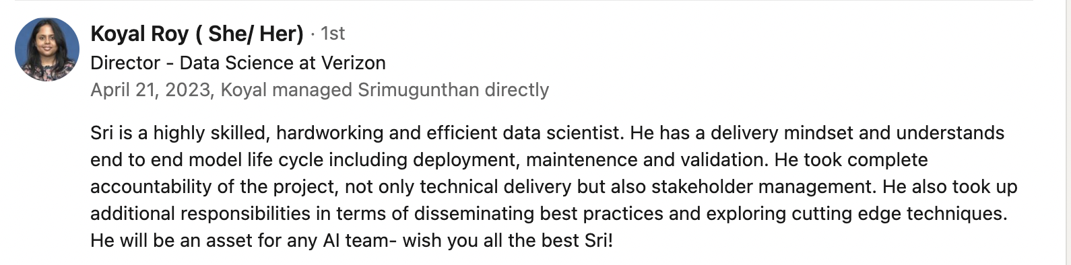
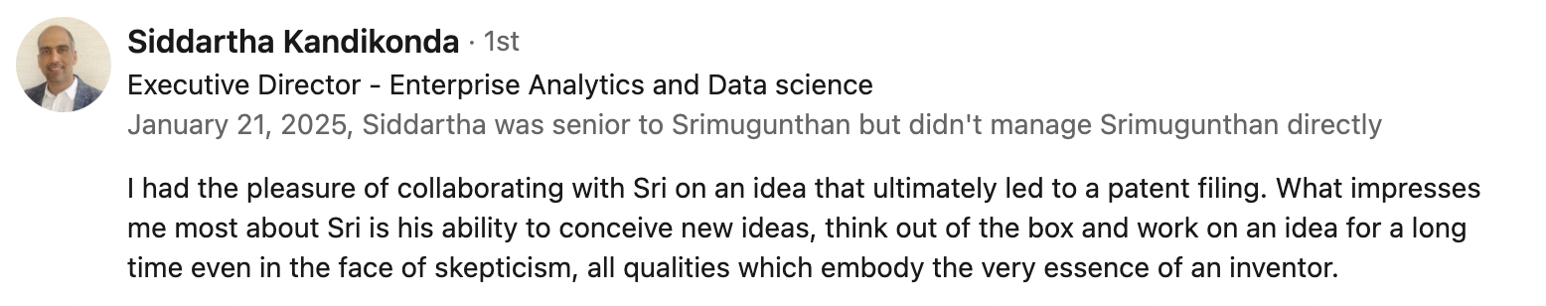
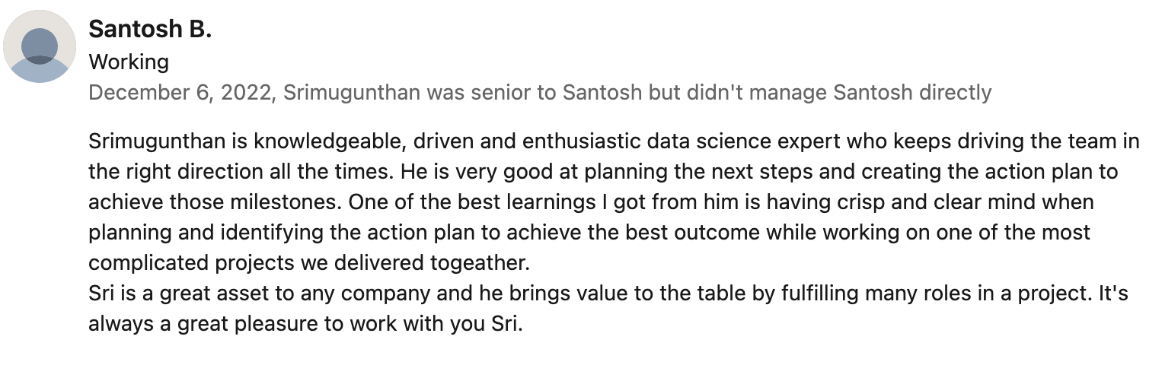
What people say about me
From someone I reported to directly
From someone I collaborated with
From someone I guided as Project-Lead

Slide 9

Next Steps
2
1
2
Message me
Email me
Call me
Message me in linkedin https://www.linkedin.com/in/srimugunthan-dhandapani/
Mail me @srimugunthan.d@gmail.com
Call me @9986561984

